Slide 1
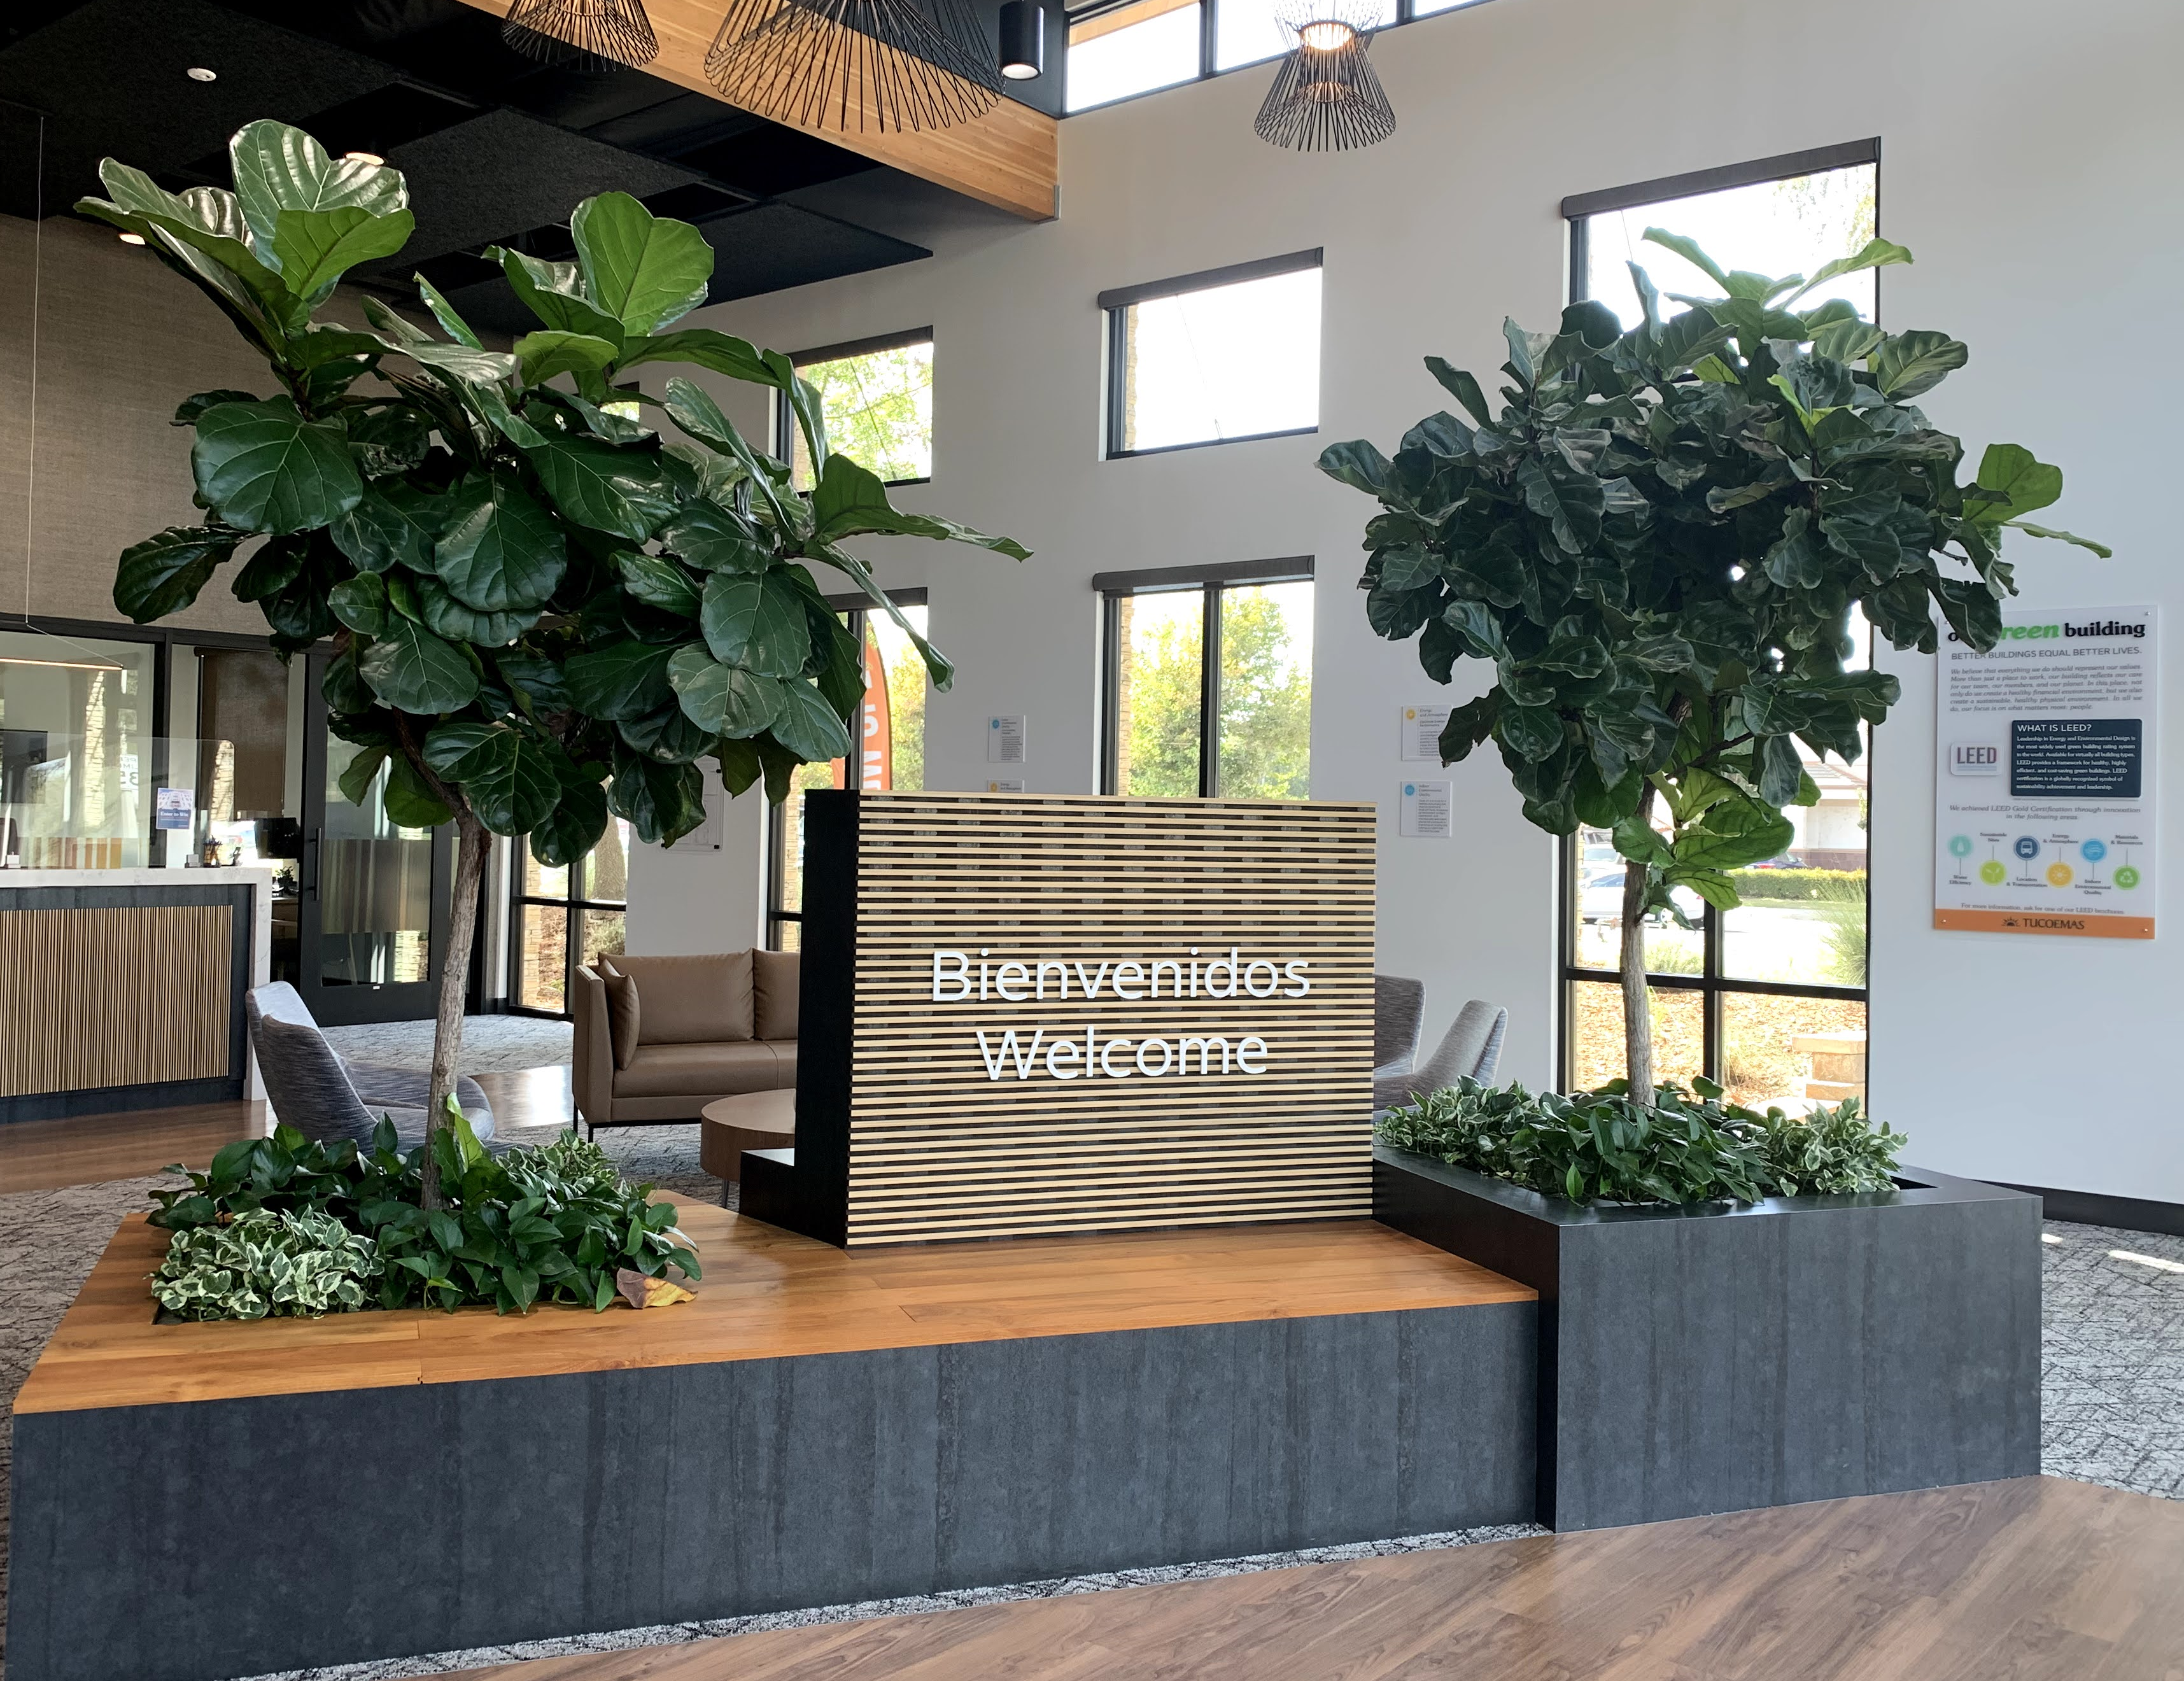
2023 Annual Report Meeting: 4/03/24

Slide 2
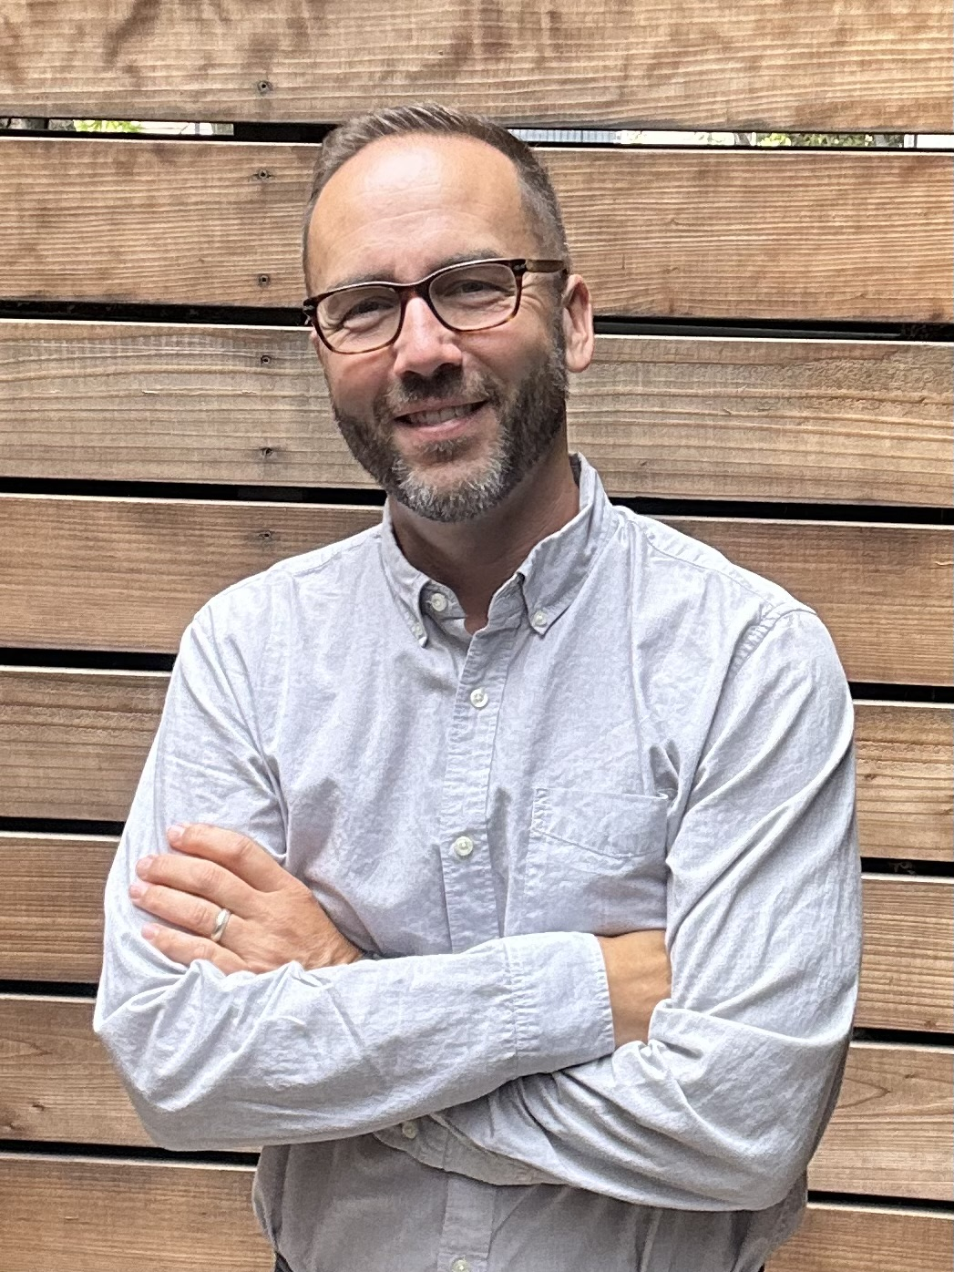
From our CEO:
“In my time at Tucoemas, we’ve enjoyed the most fruitful financial period in our 75-year history. Unfortunately, 2023 was not one of those years. Our members, faced with record inflation and rapidly rising interest rates, experienced significant financial challenges. As a community-based financial institution, we felt everyone’s pain, notably in a considerable rise in delinquencies and charge-offs as families struggled to meet their basic needs. We made every effort to work with members, but unfortunately, it wasn’t always enough.
Tucoemas also experienced rising costs, from healthcare and benefits to the cost of funds and daily operations. But to be a member-owned, local financial institution is to be ready to step into the gap when our members are hurting.
Thankfully, we’ve been blessed with more good times than bad. Since 2016, we have nearly doubled our net worth, the reserves the credit union can call on in challenging times. As a result of the efforts of our Tucoemas village, we were well-positioned to weather the storm and help our members be resilient. We continued to invest in our people, platforms and services, realizing that when hard times come, we must continue to move forward, to offer lifelines, and to improve our products and our services for our members. We must rise together.”- Brice A. Yocum, CEO

Slide 3
Statement of Financial Condition
 |  |  |  |  |  |  |  | 12/31/2022 |  | 12/31/2023
 | Assets
 |  | Cash and Cash Equivalents |  |  |  |  |  | $ 12,176,666 |  | $ 42,191,725
 |  | Investments |  |  |  |  |  | $ 149,373,333 |  | $ 137,040,450
 |  | Net Loans |  |  |  |  |  | $ 131,415,366 |  | $ 154,674,362
 |  | Property and Equipment |  |  |  |  |  | $ 12,189,270 |  | $ 11,338,048
 |  | Share Insurance Deposit |  |  |  |  |  | $ 2,931,809 |  | $ 2,785,996
 |  | Other Assets |  |  |  |  |  | $ 4,940,328 |  | $ 6,770,157
 | Total Assets |  |  |  |  |  |  | $ 313,026,772 |  | $ 354,800,738
 | Liabilities and Members' Equity
 |  | Accounts Payable and Other Liabilities |  |  |  |  |  | $ 7,464,347 |  | $ 58,677,025
 |  | Members' Shares |  |  |  |  |  | $ 288,278,148 |  | $ 276,479,817
 |  | Unrealized Gains/(Losses) |  |  |  |  |  | $ (11,359,887) |  | $ (8,944,039)
 |  | Members' Equity |  |  |  |  |  | $ 28,644,164 |  | $ 28,587,935
 | Total Liabilities and Equity |  |  |  |  |  |  | $ 313,026,772 |  | $ 354,800,738

Slide 4
Income Statement
 |  |  |  |  |  |  | 12/31/2022 |  | 12/31/2023
 | Interest Income
 |  | Interest from Loans |  |  |  |  | $ 8,667,477 |  | $ 10,640,718
 |  | Income from Investments |  |  |  |  | $ 2,297,915 |  | $ 2,620,550
 | Total Interest Income |  |  |  |  |  | $ 10,965,392 |  | $ 13,261,268
 | Operating Income |  |  |  |  |  | $ 3,770,236 |  | $ 3,609,883
 | Non-Interest Expenses
 |  | Provision for Loan Loss |  |  |  |  | $ 1,388,616 |  | $ 2,528,068
 |  | Compensation & Benefits |  |  |  |  | $ 4,417,504 |  | $ 5,180,698
 |  | Office Occupancy |  |  |  |  | $ 496,475 |  | $ 581,685
 |  | Other Operating Expenses |  |  |  |  | $ 7,429,980 |  | $ 8,425,223
 | Total Non-Interest Expenses |  |  |  |  |  | $ 13,732,575 |  | $ 16,715,674
 |  | Other Non-Operating (Gain)/Loss |  |  |  |  | $ (981,485) |  | $ (749,357)
 | Dividend Expense |  |  |  |  |  | $ 366,253 |  | $ 1,294,157
 | Net Income |  |  |  |  |  | $ 1,618,285 |  | $ (389,323)

Slide 5
Annual Meeting Minutes April 5, 2023

Slide 6
Impact on the Credit Union and our Team
Total Assets ended at $354M
Grew total loans by $23M, or nearly 18%
We had to fund our Provision $2.5M, a sign of the challenges members are facing
We experienced a loss of $389k; have added over $14M to reserves since 2017
We received $2.6M in grant funding to support our community through 2024
We invested $500k in our team through increased compensation and benefits
Provided over $88k in total impact through our 0% Impact Loans to provide emergency support for our team in times of crisis

Slide 7
Impact on Members in 2023
We opened 2147 new free Kasasa checking accounts
We provided over 3,494 new loans for members, including 662 new Visas
We put $76M worth of capital into our community
We returned $787k in dividends to members
We refunded over $55k in foreign ATM fees for Kasasa Accounts
We paid over $7k in rewards for Kasasa Cash members
We paid $290k in rewards for Kasasa Cash Back members
We paid over $81,000 to Pathways participants

Slide 8
Thank You!

